Slide 1
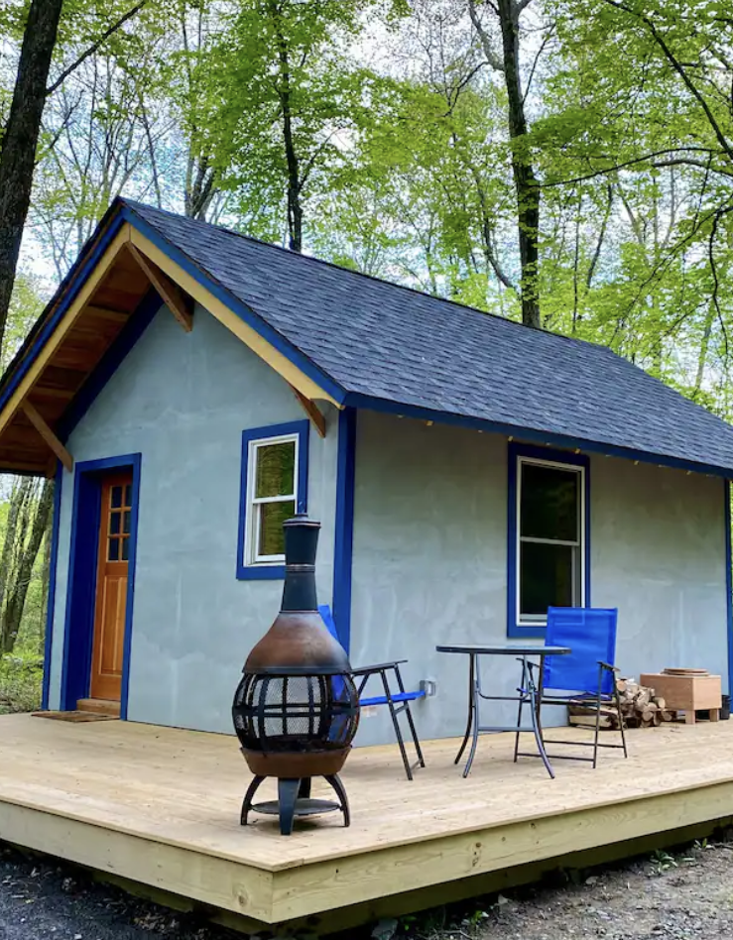
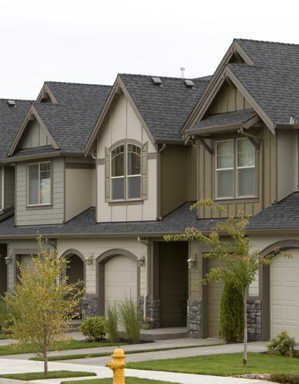
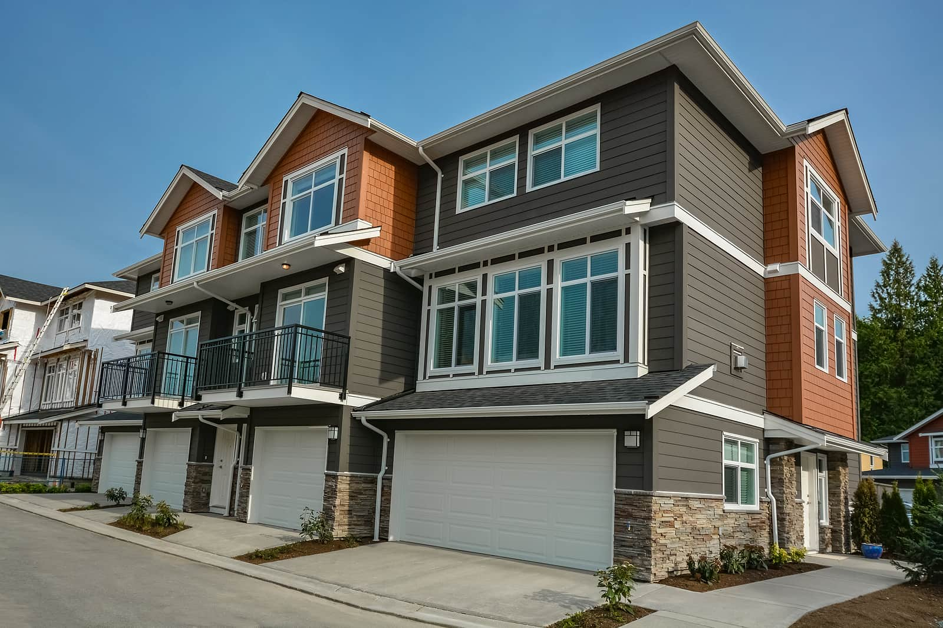
Types of homes
There are various types of homes, including:
Single-family homes: Detached houses for one family.
Apartments/Condos: Multi-unit buildings with individual living spaces.
Townhouses: Connected homes in a row or block.
Duplexes/Triplexes: Houses divided into two or three separate units.
Tiny houses: Small, compact dwellings usually under 40 square meters.
Cottages: Small, cozy houses, often in rural or scenic areas.

Slide 2
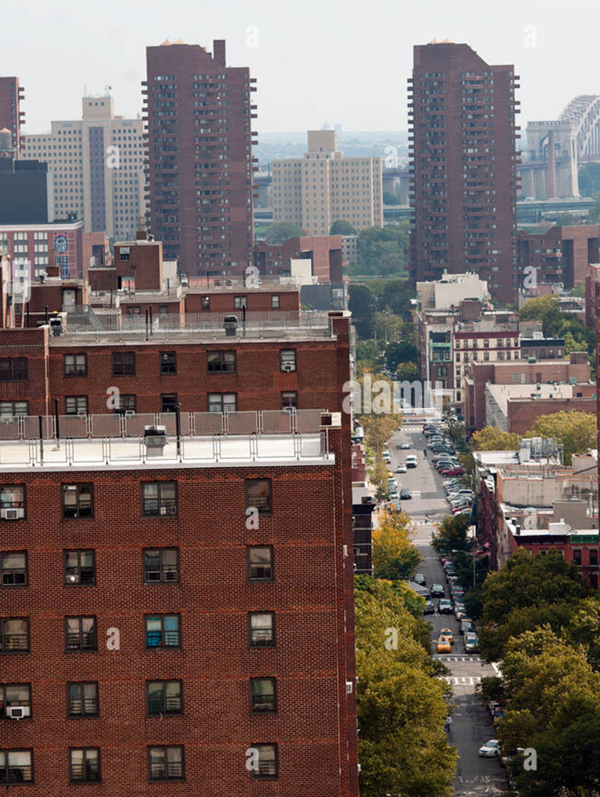
Living in a Flat:
Advantages:
Affordability: Flats are often more affordable than houses, making them accessible to a broader range of people.
Community Living: Proximity to neighbors can foster a sense of community.
Amenities: Many flats come with shared amenities like gyms, pools, and common spaces.
Maintenance: External maintenance is typically managed by the building management.

Slide 3
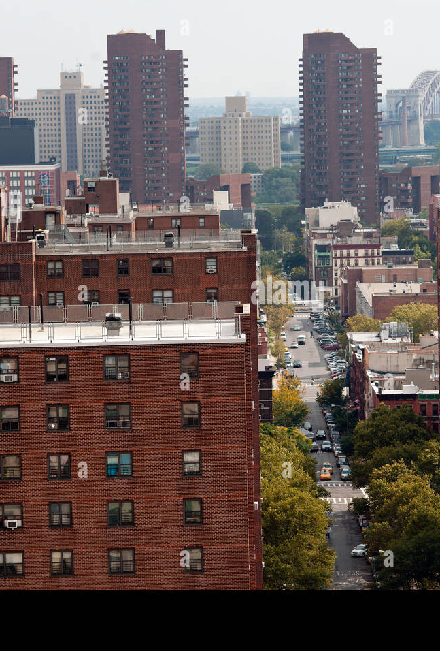
Living in a Flat:
Disadvantages:
Space: Limited space compared to houses, especially for families.
Noise: Increased potential for noise from neighbors in close proximity.
Limited Customization: Restrictions on personalizing or modifying the property.
Parking: Limited or expensive parking options, depending on location.

Slide 4
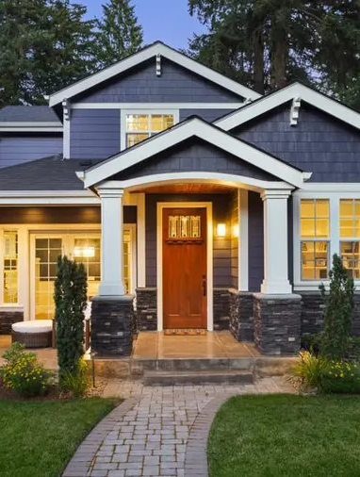
Living in a House:
Advantages:
Space: More living space, both indoors and outdoors, providing room for personalization.
Privacy: Greater privacy due to distance from neighbors.
Customization: Freedom to modify and personalize the property.
Outdoor Space: Houses often come with yards or gardens.

Slide 5
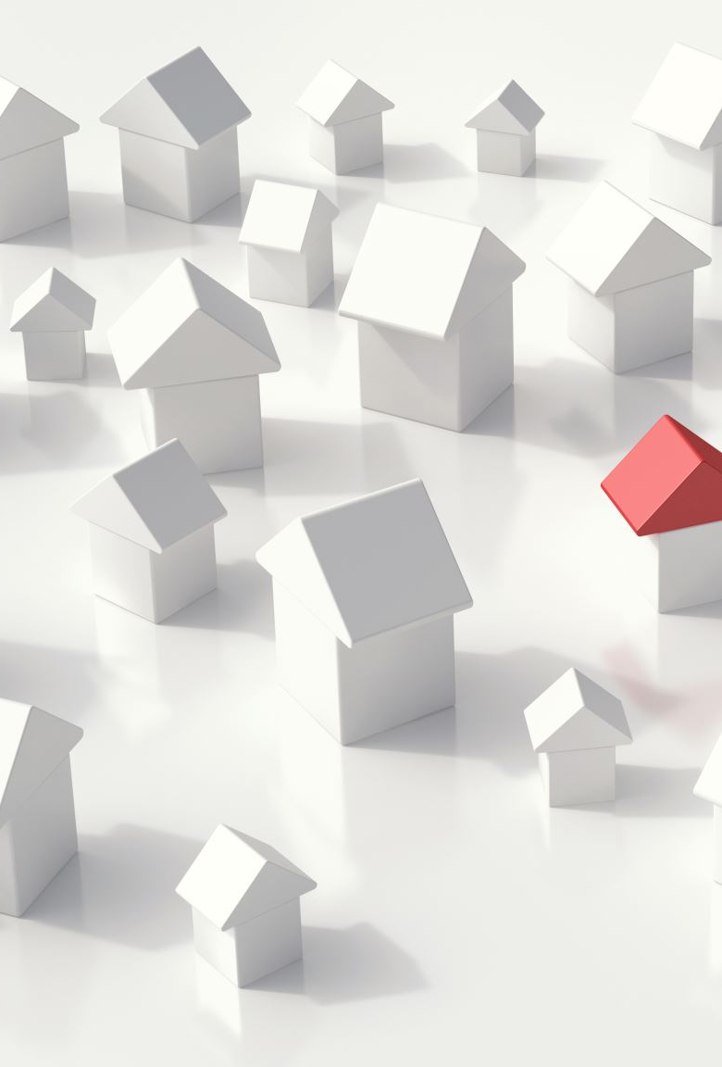
Living in a House:
Disadvantages:
Cost: Generally, more expensive to buy and maintain than flats.
Maintenance: Responsible for the maintenance of the entire property.
Isolation: Houses in remote areas might lack the sense of community found in urban flats.
Security: Depending on the location, houses might require additional security measures.

Slide 6
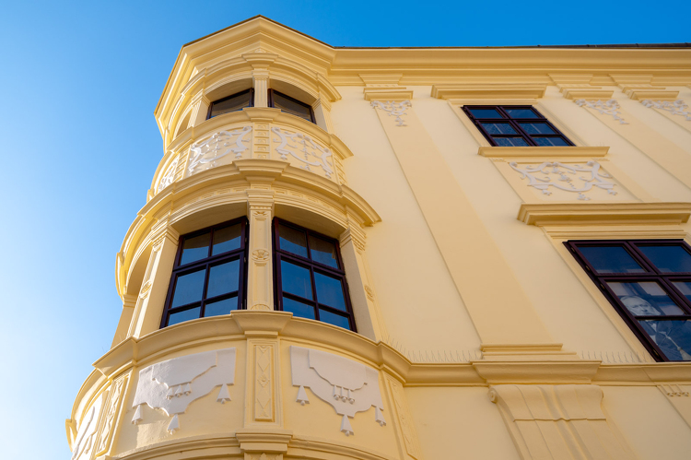
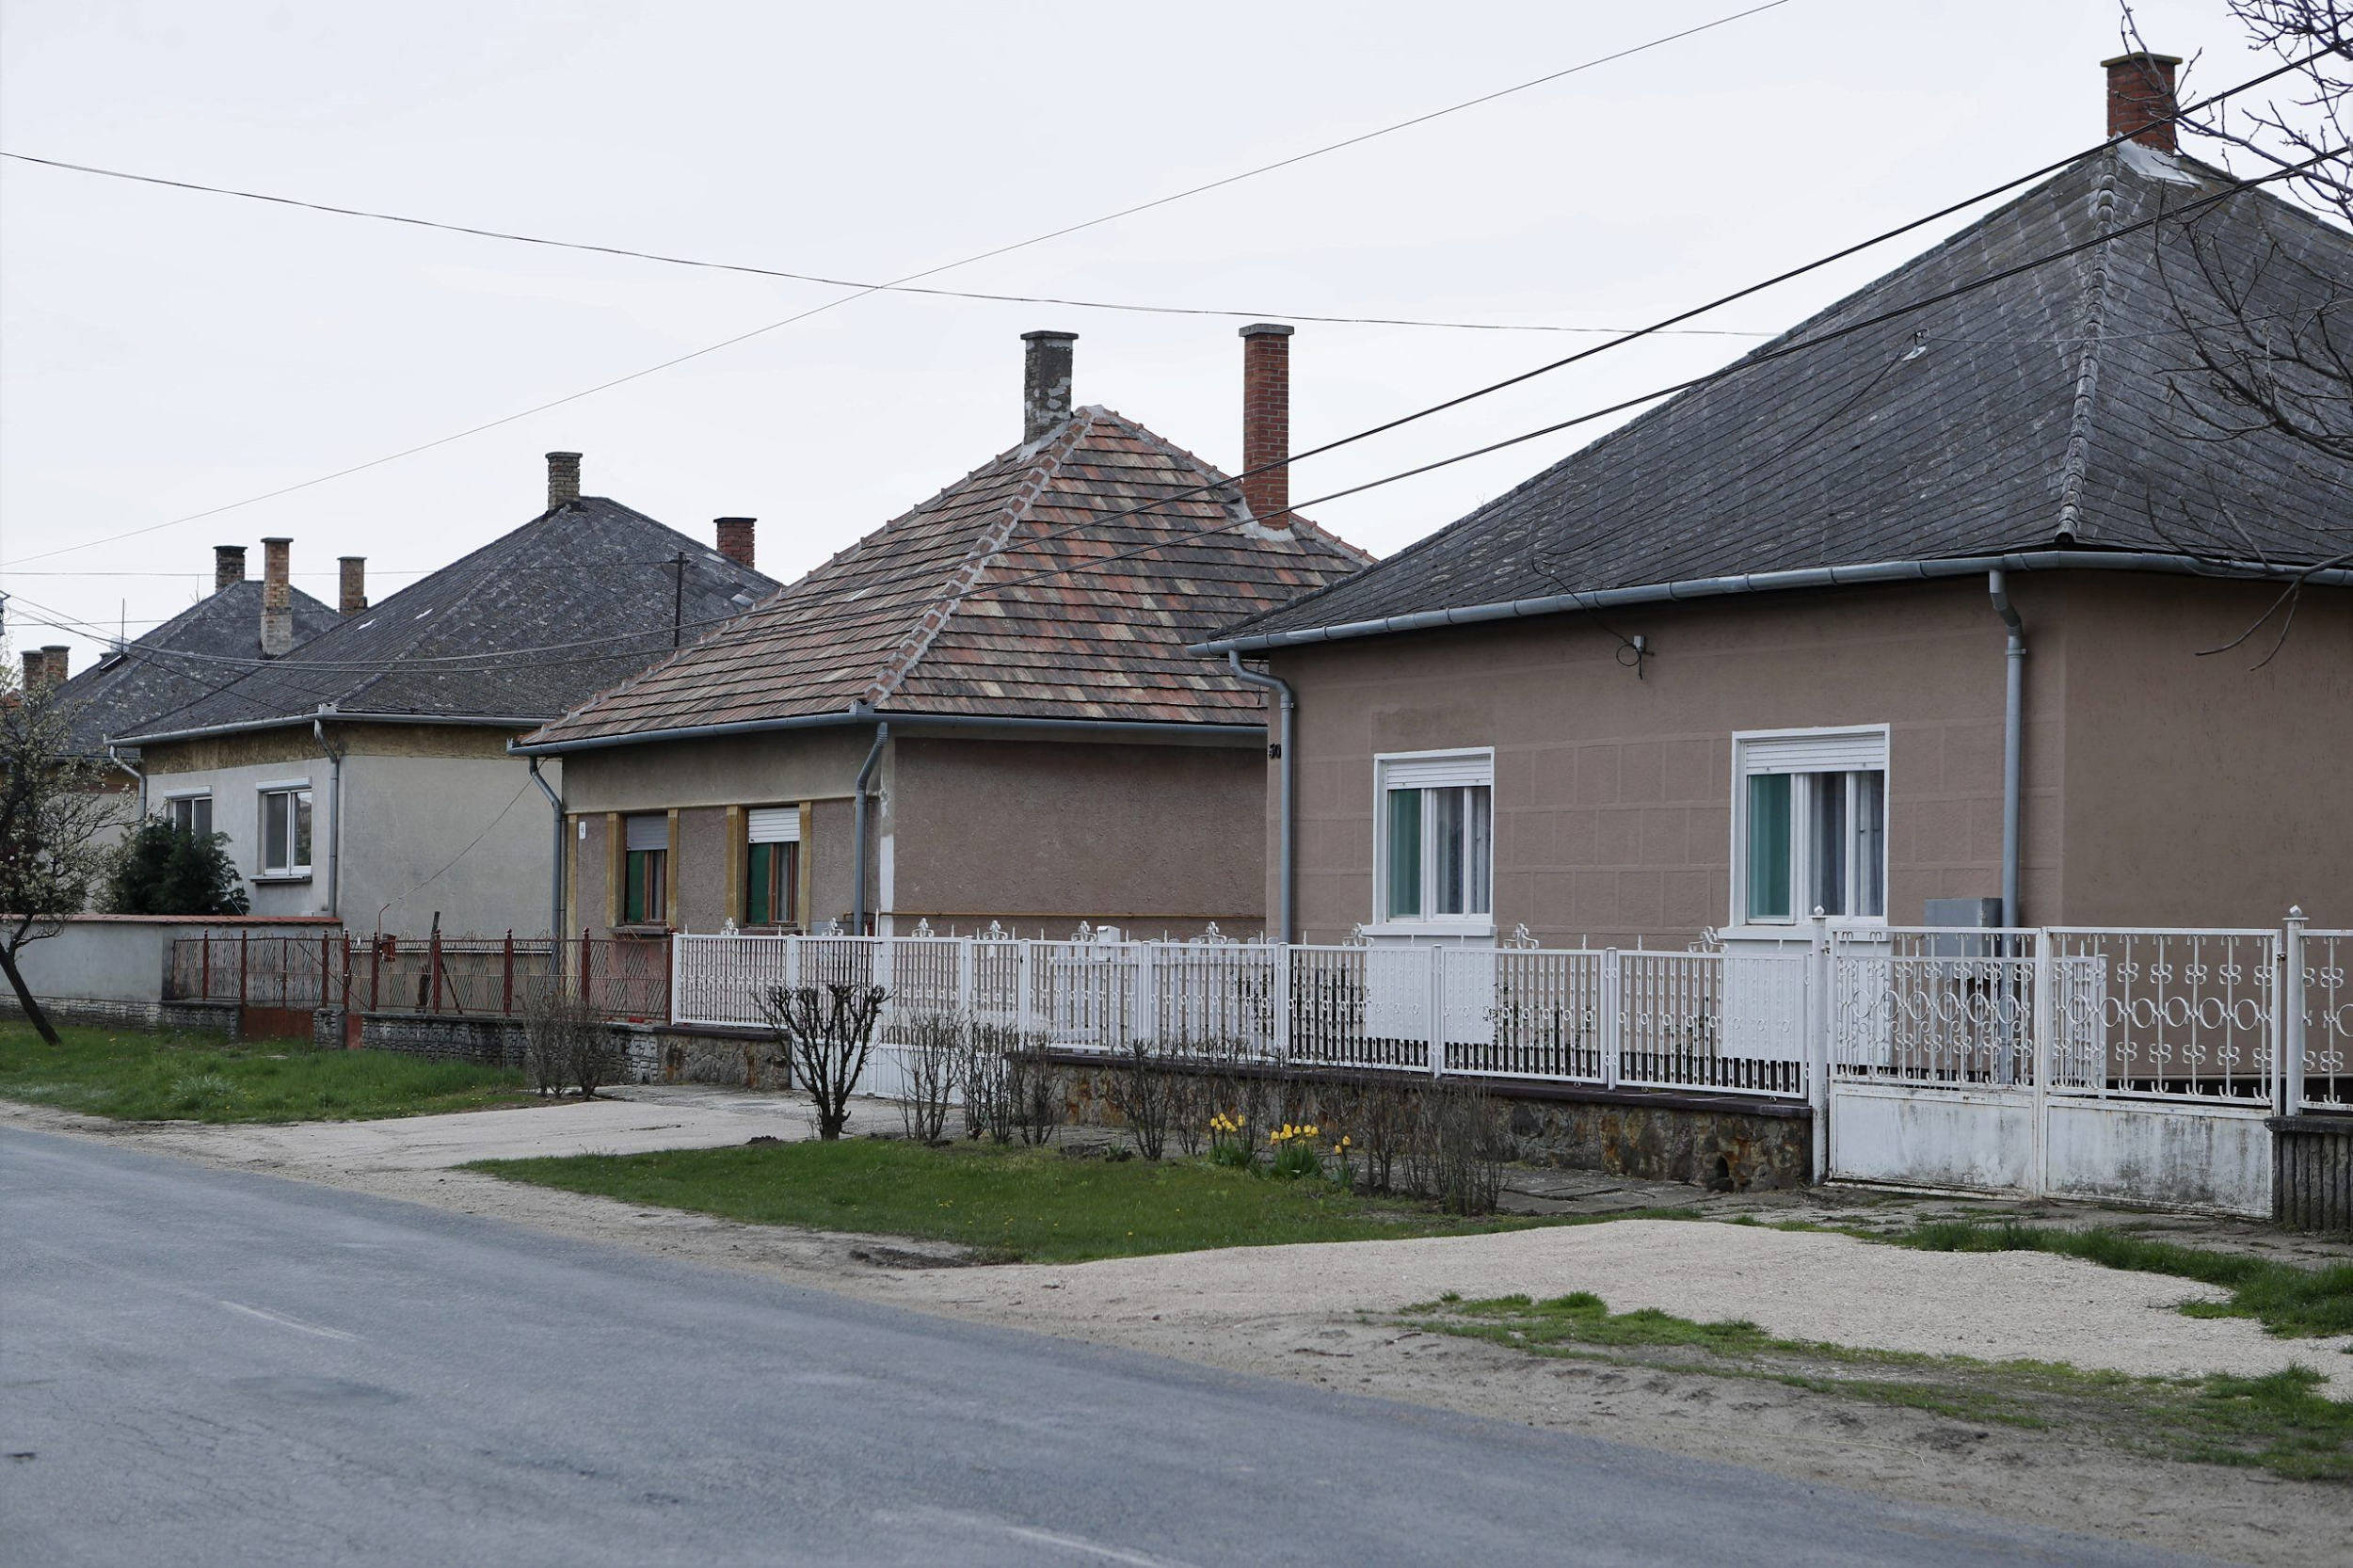
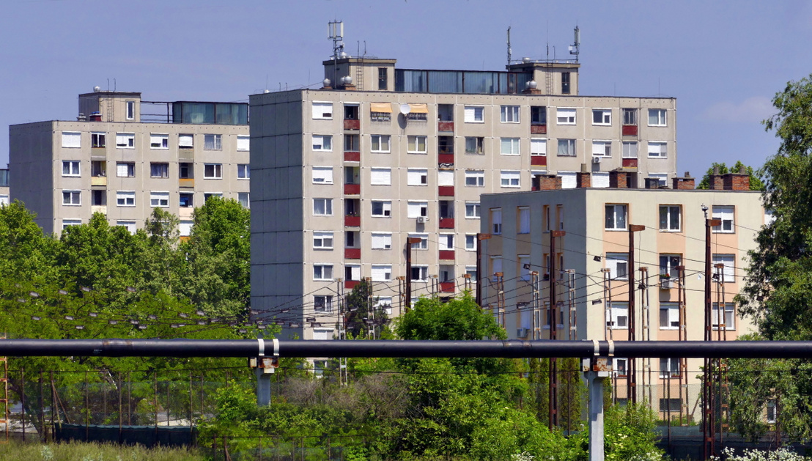
Typical homes in Hungary
Apartments: Many Hungarians live in apartment buildings, especially in urban areas like Budapest. These can range from historic buildings to more modern complexes.
Detached Houses: In suburban and rural areas, detached houses are common. These can vary in size and style, from traditional to contemporary.
Historic Homes: Hungary has a rich architectural history, so you can find homes with traditional designs influenced by various periods.
Panel Buildings: In the mid to late 20th century, panel buildings (blocks of flats with pre-fabricated panels) were constructed to address housing shortages. Many people still live in these.
Rural Cottages: In the countryside, you may find charming cottages, often with a focus on agricultural activities.
Renovated Buildings: Hungary has seen a trend of renovating historic buildings into modern apartments, combining traditional architecture with contemporary interiors.

